Slide 1
Headteacher and Chair of Governor Briefings
March 2018

Slide 2
Agenda
National and Local Updates
Closing the Gap
Governance
Assessment and Curriculum
EYFS

Slide 3
National and Local Updates
Notes:
Notes for presenters: please see detailed notes below each slide

Slide 4
The role of the Council
Ensuring the system works
Improving outcomes for vulnerable children
Acting as champions for children and families
Notes:
We have an increasingly diverse education system and this will continue. The LA therefore has a role in ensuring that the system works for children and parents despite the disparate range of providers in the system.
Although the vast majority of children and young people achieve well and have access to good educational provision, there is a proportion of cyp who are vulnerable and disadvantaged. There are pupils who do not achieve well and who underachieve. Improving outcomes and closing the gaps for these pupils are a high priority for the council.
Key issues driving the need for changes the council are:
Outcomes
Changing role of the County Council in Education
Funding
The changes are largely internal. Whilst there have been changes internally for members of staff and teams, many have been subject to adjustment rather than significant change. The result should be a more effective and efficient service for schools and settings.

Slide 5
New education structure
Three service areas under Tim Browne, Head of Education:
• Education Outcomes & Intervention - Jane Lloyd Davies
• Commissioning for Learning - Clare Medland
• Services for Children with Additional Needs - Charlotte Jones
Notes:
In order to cover the functions effectively and efficiently – we have re-shaped the education teams.

Slide 6
Education Outcomes and Intervention
Education Leads & Performance Advisers - support and intervention, ensuring action towards improvement; supporting collaboration and structural change; delivery of the National Curriculum; delivery of statutory and non-statutory responsibilities in relation to governor services, newly qualified teachers and assessment. This team works in partnership with system leaders, Ofsted and the office of the Regional Schools Commissioner.
Lead for health and wellbeing (lead officer – Fiona Quan ) - training, advice and guidance to schools on a range of areas related to the health and well being including the PSHE curriculum and the on-line pupil survey
HR business partner for schools (Margaret Wilkins) - providing a range of specialist advice to schools alongside the education outcomes and intervention team.
Notes:
Education leads & Performance Advisers
Responsible for: coordination of challenge, support and intervention to ensure high quality educational provision for all children and young people, ensuring rapid and appropriate action is taken in schools and settings causing concern across all phases, development of robust improvement strategies; supporting schools with school collaboration and structural change; supporting the delivery of the National Curriculum in maintained schools; delivery of statutory and non-statutory responsibilities of the LA in relation to governor services, newly qualified teachers and assessment. This area also has close liaison and partnership with system leaders, Ofsted and the office of the Regional Schools Commissioner).
Lead for health and wellbeing (lead officer – Fiona Quan )
Responsible for: training, advice and guidance to schools on a range of areas related to the health and well being of children and young people including the PSHE curriculum and the on-line pupil survey
HR business partner for schools (Margaret Wilkins)
Responsible for: providing a range of specialist advice to schools alongside the education outcomes and intervention team

Slide 7
Early Years Service
Responsible for:
statutory and non-statutory duties re improving outcomes and reducing inequalities for children aged 0-5
building the quality and capacity of early years providers across the maintained, private, voluntary and independent sector
creating the flexibility to provide a higher level of intervention for those children with the most complex needs and commissioning more specialist provision
supporting the development of the early years and childcare market to address gaps and support the sufficiency of high quality places.
Notes:
Responsible for: bringing together the statutory and non-statutory duties for local authorities in relation to improving outcomes and reducing inequalities for all young children aged 0-5, building the quality and capacity of early years providers across the maintained, private, voluntary and independent sector, whilst creating the flexibility to provide a higher level of intervention for those children with the most complex needs through assessment places and commissioning more specialist provision. This area supports the development of the early years and childcare market to address gaps and support the sufficiency of high quality places.

Slide 8
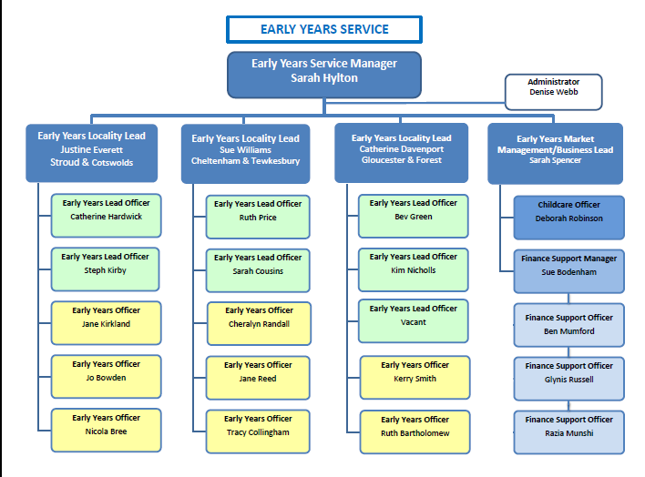

Slide 9
Virtual School for Children in Care (Headteacher – Jane Featherstone)
Gloucestershire Music (Head of GM - Lisa Mayo) and Make Music Gloucestershire

Slide 10
Commissioning for Learning
Universal Commissioning (Service manager Gareth Vine)
Specialist Commissioning (Service manager tbc)
Post 16 (Service manager tbc)
Data Hub (Service manager Cindy Gazzard)
Notes:
Universal Commissioning (Service manager – Gareth Vine)
Responsible for: ensuring sufficiency of mainstream and specialist education places across the county; including overseeing new schools or expansions, admissions to reception, year 3 in infant schools and year 7 in secondary, transport support and free school meals. Specialist Commissioning (Service manager - TBC)
Responsible for: ensuring appropriate provision is commissioned for those children and young people (0-25) with the most complex needs; including alternative provision, special schools, independent placements and bespoke packages of support. Post 16 (Service manager – TBC)
Responsible for: ensuring that systems and structures are in place to enable young people aged 16-25 to move through into education, apprenticeships, training and employment as appropriate.
Responsible for: holding and analysing all education data to ensure that resources can be effectively targeted to improve outcomes for children and young people
Head of Service: Clare Medland

Slide 11
Services for Children with Additional Needs
Access to Education (Service Manager - Sam Roberts)
Education Inclusion (Service Manager - Lisa Meggs)
EHCP Service (Service Manager - TBC)
Engagement & Quality (Edel Keating)
Education Psychology Service & Advisory Teaching Service (Service Manager Deborah Shepherd)
Notes:
Lisa Meggs will do these slides if attending: Access to Education (Service Manager - Sam Roberts)
Responsible for: ensuring that all children and young people are able to secure a school place; including in-year admissions to schools, the placement of vulnerable children, school appeals, children missing education and discretionary travel assistance.
Education Inclusion (Service Manager - Lisa Meggs)
Responsible for: supporting children and young people to stay in school; including responding to exclusions, attendance issues, overseeing elective home education and child employment/entertainment.
EHCP Service (Service Manager - TBC)
Responsible for: ensuring children and young people (0-25) whose level of Special Educational Need and/or Disability (SEND) requires an Education, Health & Care plan are appropriately supported within schools; including assessing need, overseeing funding allocation to schools and enabling children and young people to travel to education settings.
Engagement & Quality (Edel Keating)
Responsible for: ensuring full engagement and coproduction across education with all other agencies, parent carers and young people.
Education Psychology Service & Advisory Teaching Service (Service Manager Deborah Shepherd) .
Stewart King will continue is his role as Lead Commissioner for Education Strategy and Development - leading on school funding, including the High Needs Strategy/Programme.
Although the new Education Hub structure has been in place since January, some posts remain vacant as interviews continue.

Slide 12

Services for Children with Additional Needs
Access to Education– ensuring children can access a school place
Education Inclusion – ensuring children with additional needs are supported to remain in school and achieve
EHCP – ensuring children with most complex SEN are well supported through the EHCP process
Advisory Teaching Service & Educational Psychology – helping to build specialist knowledge in schools and support children
Engagement & Quality – ensuring co-production with parent/carers and children & young people and integration with health & social care
Notes:
Whole purpose of this service is to ensure that all children are able to access school and make the most of their education experience
recognising that those with additional needs may need some support to achieve this
It therefore covers the whole range of activity from in-year admissions and children missing education through to education, exclusions, attendance, EHE, and then those pupils who require an EHCP
making sure that individual children and schools have the support they need.
Having all of this in one service should mean we are better able to respond to a child’s needs rather than deciding what service they need to be referred to.
It also gives us the opportunity to look at how we can support schools and children with early intervention and trying to resolve issues for CYP before they escalate.
The service is also very interested in how well we have integrated co-production with parents/carers and other agencies into our SEND/EHCP work and looking at how we can increase that across the whole of education.
A big area here is for us to focus more on getting the voice of CYP to inform our work
Full co-production is really important; it is vital, given the challenges we are facing, that we really understand what things are like for our CYP and use their experiences to help shape what we do moving forward

Slide 13

Education Inclusion
Manager: Lisa Meggs
Locality Lead Cheltenham and Tewkesbury: Vikki Burt
Locality Lead Stroud and Cotswold: Nathan Roe
Locality Lead Gloucester and Forest: Jamie Ford
Service includes Outcome Coordinators and Inclusion Officers, plus educational expertise in the MASH.
In ensuring children with additional needs are supported to remain in school and achieve, responsibilities include:
Ensuring CYP have access to an education appropriate to meet their needs through supporting families and education settings in the development of inclusive practice and environments
Supporting families and educational settings to take early action to address emerging issues
Meeting statutory duties for attendance, exclusion, home education and children in employment / entertainment
Notes:
Please apologise that I am not able to be there if I am not there; today wanted to further welcome you to our team following the introduction to our service that has been shared with schools recently.
New service bringing together a number of roles and oversights with new roles and team members.
The introduction shared with schools recently gives further detail as to who we are, our work, and how we can support you. We are also very happy to come to speak to your groups of local schools – please ask if schools would find it useful for us to do this.

Slide 14
Exclusions: exclusions@gloucestershire.gov.uk
CME: missingpupils@gloucestershire.gov.uk
Attendance: attendance@gloucestershire.gov.uk
Governor Services: governor.services@gloucestershire.gov.uk
Assessment: Assessment@gloucestershire.gov.uk
GHLL: GHLL@gloucestershire.gov.uk
EHE: EHE@gloucestershire.gov.uk
NQTs: NQTs@gloucestershire.gov.uk
Early Years: earlyyearsteam@gloucestershire.gov.uk
Ofsted notification contacts:
01452 427161 or
01452 427308
Education Outcomes and Intervention
Jane Lloyd-Davies
Head of Education Performance & Inclusion (01452) 328691
Jane.Lloyd-Davies@ gloucestershire.gov.uk
Sandra Shepherd
Education Lead
Caroline Coates
Education Lead
Barry Jones
Education Lead
Sarah Hylton
Early Years Service Manager
Education Leads
Performance Advisers
Elspeth Murano
Cath Liptrot
Jane Pritchard-Meaker
Tim Foster
Fiona McMorrow
Deb Harris
Sandra Parker
Anna Barker
Fiona Quan
Sara Vestey
Vanessa Grimshaw
HR & Governor Services
Jennie Leighton
Governor Services
Wendy Gallagher
Governor Services
Anne Lloyd
NQT Co-ordinator
Margaret Wilkins
HR Business Partner Schools
Notes:
Overall EOI structure chart

Slide 15
Arrangements for supporting school improvement
Addressing underperformance and schools causing concern through early intervention
Developing school to school support through the identification of best practice and brokering expertise from local schools
Notes:
As stated earlier, a main function of the LA and of the EO&I team is to support school improvement. Schools are essentially responsible for determining their own school improvement in response to their self-evaluation. Since 2011, schools have been expected to secure their own school improvement partners or similar and to access training from wherever they choose and to identify their own providers of CPD.
The LA has continues to provide a range of resources to support school improvement and has a role in the identification of schools at risk and intervention in local authority maintained schools.
The LA acts are a significant partner in the system, securing system leadership and schoo to school support.

Slide 16
National Context
Autonomy of schools
Greater choice for parents
Funding delegated to schools
Increasingly rigorous and changing Ofsted inspections
School improvement through system leadership and school to school support
Changes to the curriculum and exam system

Slide 17
Inspection Outcomes
93.4% of primary aged pupils attend good or outstanding schools; 82.4% secondary aged pupils attend good or outstanding schools
5 schools are inadequate
Watchsted 01.03.2018
Notes:
Gloucestershire Ofsted Outcomes - 01 March 2018
93.4% primary aged pupils currently attend Good or Outstanding schools. Gloucestershire is ranked 2nd in the South West.
82.4% secondary aged pupils attend Good or Outstanding schools. Gloucestershire is ranked 11th in the South West.
Inadequate:
Cam Woodfield Junior
Chesterton
Grange Primary
St Anthony's School (Free School)
The Forest High School (A)

Slide 18
Number of primary schools in Gloucestershire | 248
Number of maintained primary schools | 199
Number of primary academies | 46
Number of primary free schools | 3
Number of secondary schools in Gloucestershire | 40
Number of maintained secondary schools | 5
Number of secondary academies | 34
Number of secondary free schools | 1
Number of special schools in Gloucestershire | 11
Number of maintained special schools | 8
Number of special academies | 3
Number of special free schools | 1
Number of free schools | 5 (3 primary, 1 APS, 1 UTC)
Number of alternative provision schools | 5 (inc 1 free school and Hospital Education Service)

Slide 19
Safeguarding
External
Consultants
Data &
Information
Targeted Support Teams
Inclusion Team
Healthy Living & Learning & Online Pupil Survey
School
Improvement
GlosED directory of providers
Early Help & Families First
Other providers
inc teaching schools
HR & Finance
Headteachers & Governors
Relationships Partnership Influence
Notes:
Effective school improvement is supported by a range of local sources of support and intervention…
We invest in relationships across the system
The influence of the LA (limited powers)
The quality of partnership – as demonstrated by the joint working of MATs TSAs and LA to develop SSIF bids

Slide 20

Notes:
The LA’s powers in relation to schools causing concern are set out in this document.

Slide 21
Identification
Self-referral
Use of an Ofsted-style risk assessment model – performance data, distance from inspection
Scrutiny of data and information (e.g. Ofsted ratings and recommendations, pupil numbers, attendance and exclusion rates, governor vacancies, budget deficits, staff turnover)
Softer information – parental concerns, governor issues and queries, attendance/non-attendance at briefings
Reference to common characteristics of schools causing concern

Slide 22
Addressing school (and academy) under-performance and ensuring high standards
Academies
Maintained schools
Local influence/keeping in touch
Referral to RSC or Ofsted
Support for schools causing concern (including RI)
Intervention in schools in Ofsted categories

Slide 23
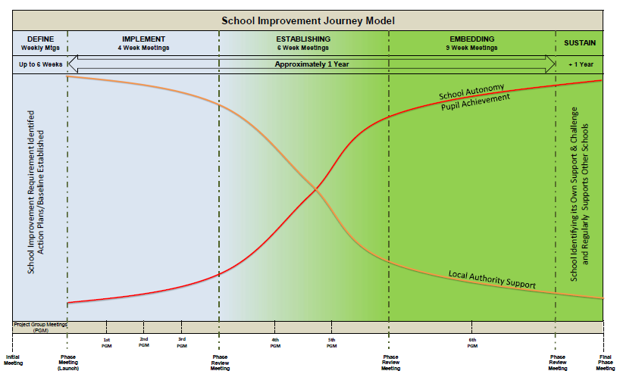
Notes:
This model sets out the School Improvement Journey.
Well received and understood importantly by Ofsted and HMI

Slide 24
School Improvement Journey
Easily understood and intuitive
Model shows the timeline of the improvement journey
School autonomy increases and LA support reduces
Well documented , phased approach
Regular project group meetings and phase reviews

Slide 25
Tools include:
Risk assessment, checklist, scoping tool (is/is not)
SMART criteria (specific, measurable, achievable, relevant and time bound)
RACI chart (responsible, accountable, consulted, informed)
GANTT chart
Communication strategy
Journey charters
Notes:
Bespoke to the context and needs of the school
Gantt chart – a bar chart with start and finish dates including resources, milestones etc.

Slide 26
Key drivers:
Raising Achievement Plan (RAP)
Project group including Project Lead, Headteacher, Chair of Governors, HR, Finance
Consultant Headteachers and schools
External Consultants
GlosEd Leaders
Governor trainers
Notes:
Important to note that the LA officer/adviser co-ordinates and facilitates the project group. However, the LA does not lead the PG, it is a shared responsibility and over time the leadership of improvement moves to the school at which point, the LA’s role diminishes and the school will exit the PG when is becomes secure/ judged to be Good.

Slide 27
Our Partners
Gloucestershire Association of Secondary Headteachers
Gloucestershire Association of Primary Headteachers
Gloucestershire Association of Special Headteachers
Primary Partnerships and Clusters
Gloucestershire Governors’ Association
Dioceses
Academy sponsors
Teaching schools and alliances; Maths Hub
Others, e.g. EEF

Slide 28
Universal offer to schools includes:
English, maths and science network; newsletters; secondary senior leaders meetings; SENCO clusters; attendance networks
Newly qualified teacher programme of training (in association with Heads and Adfecto)
Closing the Gaps workshops and annual conference
Headteacher, governor and clerk briefings
New and acting Heads programme
Single issue school led improvement model
Bespoke training in response to local needs
Early Years
Governor services
Other training that is commissioned/brokered
GHLL
Assessment and moderation networks

Slide 29
Inspections of Primary Schools Aug 2014 to March 2018
 | 2014 | 2018
Outstanding | 18% | 19.8%
Good | 71% | 71.5%
RI | 9% | 6.6%
Inadequate | 2% | 2.1%
Source: Ofsted Data View and Watchsted
Notes:
Against the backdrop of changing frameworks and perceived increased challenge from Ofsted, inspection in the primary sector has seen the profile improve marginally over time.
Meanwhile, the profile of Secondary schools is more volatile –
81.6% secondary schools currently judged good or better. 26.3% outstanding; 55.3% good; 13.2% RI, 5.3% inadequate.

Slide 30
Strategic School Improvement Fund (SSIF)
3 successful applications in SSIF 2:
Developing precision teaching of oracy and phonics through an understanding of early language acquisition, using robust assessment tools.
Reducing the reading achievement gap and improving literacy skills and progress for Key Stage 2 pupils with a particular focus on those with SEND and in receipt of Pupil Premium.
The third project led by Balcarras School is designed to address progress in mathematics at Key Stage 2.
Notes:
SSIF 1Grant total: £115,040
Gloucestershire LA submitted 3 applications in Round 1 all of which were in partnership with Teaching Schools in the county. Although none of the applications were successful, the feedback from the RSC and NCTL was extremely positive.
SSIF 2 Grant total: £100,465
The LA submitted two SSIF applications in Round 2, both of which were successful. A third application was submitted by Balcarras School (a teaching school) with the LA as a partner; this application was also successful.
The two LA projects are:
1. SSIF R2 020: developing precision teaching of oracy and phonics through an understanding of early language acquisition, using robust assessment tools.
Grant total: £115,040
The providers are Pate’s Grammar School (Odyssey Teaching School Alliance) and The Gloucestershire Learning Alliance (Multi-Academy Trust inc Bishop’s Cleeve and Rowanfield Schools) together with The Milestone Special School as part of the Coney Hill Milestone Teaching School.
Twelve schools are involved in the project and will be in receipt of the support. All meet the eligibility criteria. The schools are:
Calton Primary
Finlay Primary
Grange Primary
Hatherley Infant
Kingsholm CoE Primary
Moat Primary (A)
Queen Margaret Primary
Rowanfield Infant (A)
Severnbanks Primary (A)
Springbank Primary (A)
St Paul’s CoE Primary
Widden Primary
The LA supported a pilot project prior to hearing the outcome of the bid; early indications are that the programme is already having a significant positive impact.
2. SSIF R2 026: reducing the reading achievement gap and improving literacy skills and progress for Key Stage 2 pupils with a particular focus on those with SEND and in receipt of Pupil Premium.
Grant total: £100,465
The provider is The Milestone Teaching School. The 10 primary and 3 secondary schools involved in the project and in receipt of support are in the Forest of Dean. The schools are:
The Forest High School (A)
The Dean Academy (A)
Five Acres Academy (A)
Berry Hill Primary
Blakeney Primary (under executive headship with Pillowell and Walmore Hill)
Bream CoE Primary
Coalway Junior
Drybrook Primary
Ellwood Primary
Picklenash Primary
St John’s CoE Primary (A)
St White’s Primary
Steam Mills Primary
The third project led by Balcarras School is designed to address progress in mathematics at Key Stage 2. The LA is providing support for the monitoring and evaluation of the project.

Slide 31
Local Partnership Board – Principles:
Its purpose is to support the progress and achievement of all children and young people in Gloucestershire
Membership will be open to all schools, irrespective of type, and all schools will be treated equally
Led by headteachers, with the support of key strategic partners – the local authority, governors, the Diocese and the RSC
Committed to releasing the capacity and expertise in the system to support schools, and recognising that all schools can have something to offer and have something to learn
A non-punitive mechanism for identifying areas for improvement, and doing something about them
Focused on action, evidence based, and driven by impact

Slide 32
Local Partnership Board - so far:
Carried out phone interviews – mix of headteachers, MAT CEOs, Diocese and RSC office
Basic data analysis of key challenges facing schools in Gloucestershire
Background research into other education partnerships
Workshops with headteachers
Presentations at GASH and GAPH
Discussion through the steering group
Developing a more concrete proposition
Written consultation with all schools
Piloting key aspects of the proposal
Notes:
The Isos Partnership has worked on behalf of the LA to support the development of a Local Partnership Board. This is not the responsibility of the LA but we have facilitated the steering group etc. The Board will represent all schools in the county.
Encourage Heads and governors to respond to the consultation.

Slide 33


GHLL and Active Gloucestershire
What’s happening this year?
Introduced 9 target schools to research based behaviour to change practice. Purpose: provide support to increase physical activity levels of the least active pupils. Aim: set up opportunities for schools to share ‘good practice’ (2018-19)
Relaunched Gloucestershire ‘Daily Mile’. Over 1/3 of primary schools are now participating. New package includes free materials such as maps, stickers, useful tips from schools already engaged.
Sign up at www.oldspotstrail.co.uk or contact tomhall@activegloucestershire.org
Starting to support schools to capture wider outcomes of increased physical activity by sharing strategies to snapshot impact on emotional wellbeing, social skills, concentration, behaviour change, for example.
Notes:
Notes: Please see the notes to accompany these 3 slides

Slide 34


GHLL and Active Gloucestershire
How can we help you?
We can support you in school to:
maximise the impact of your PE and Sport Premium funding. Active Gloucestershire offer a free advisory service and school visits are available.
set up your Daily Mile.
set up physical activity interventions.
help you analyse and document the impact and outcomes of your interventions.
Please ensure your PE and Sport premium reporting template has been uploaded onto your website by 1 April – for further details please contact tomhall@activegloucestershire.org or chris.powell@ghll.org.uk
Notes:
GHLL is FREE to all settings!

Slide 35

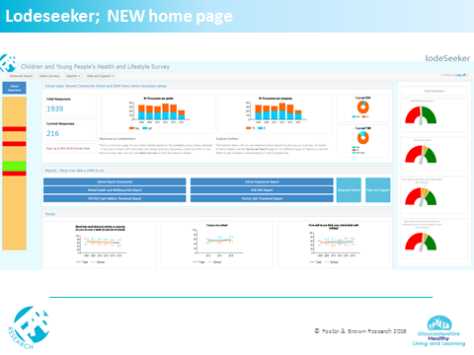
On-line Pupil Survey 2018
Number schools signed up 312
Students Logged in to-date 21,881
New dashboard homepage for Lodeseeker
2016 with your schools summary and reports
https://gcc2016ls.fabsurveys.co.uk
Closing date 23rd March 2018
Results for 2018 available in June
Notes:
Stats as of 8th March 2018
Please note closing date – is the official line although can have the following week if there is the need but we dont want to make this common knowledge!!

Slide 36
Moving towards statutory RSE!
Children and Social Work Act introduces statutory relationships and sex education across all secondary schools, and statutory relationships education across all primary schools.
Faith schools will retain the right to teach according to the tenets of their faith – within requirement of Equality Act - Church of England and Catholic Education Service in support of statutory status
Development of guidance led by Ian Bauckham CBE, with consultation with schools, young people and parents to determine content of RSE and on the fit with PSHE – closed on 12th February 18
Final statutory guidance will be published in 2018, ready for delivery in September 2019, but..
Schools do not need to wait to make improvements to quality and delivery of RSE – the legislation will build on existing effective practice

Slide 37

This teacher's planning and resource pack has been produced by the Gloucestershire Healthy Living and Learning Team by both teachers in the county and sexual health specialists.
It is intended that quality, universal RSE should become available throughout Gloucestershire. Contact ghll@gloucestershire.gov.uk for more information

Slide 38
Free Events Fischer Family Trust (FFT), Analysing School Performance (ASP) and the Inspection Dashboard Summary Report (IDSR)
Date 23rd April 2018
Times either 9.30-12.00 or 12.30-15.00
Venue The Pavilion Cheltenham GL51 6PN
This is a complimentary two hour presentation delivered by FFT where you will learn about the key features of the new FFT Aspire, ASP and IDSR systems.
Apply via GCCPlus: https://www.gloucestershire.gov.uk/schoolsnet/gccplus/
Delegates will need to bring along a copy of their school’s FFT Aspire School Dashboard/print out of ASP and IDSR.
1 free place per school

Slide 39
Ofsted Inspections Update
Notes:
Note for presenters: Please see detailed notes for each slide.

Slide 40


Ofsted
Notes:
Wanted to share with you some of the recent Ofsted experiences since the changes in January.
Quick reminder of those changes…
Section 5 inspections remain the same, ie, 2 day ‘full’ inspection’, (graded judgement against all areas + an overall effectiveness grade)
For schools previously judged as RI, and for approx 20% of good schools if Ofsted’s risk assessment indicates the quality of provision may have deteriorated significantly.
Section 8 inspections – the 1 day, short inspection (Key lines of enquiry – no graded judgement + no change to OE grade) – for previously good schools – is the one that had most significant changes.
Section 8 also the only way Ofsted can inspect an exempt school (outstanding schools)
The purpose of the s8 inspection is still to answer 2 questions
But there are now a number of possible outcomes…

Slide 41
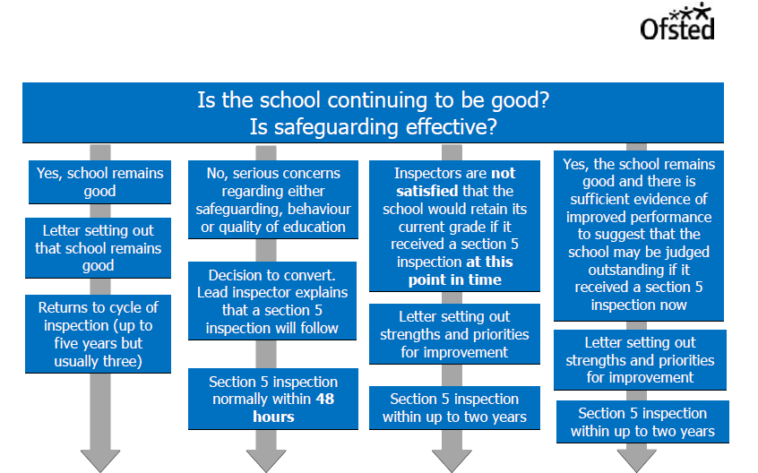
Notes:
The purpose of the s8 inspection is still to answer 2 questions
- Is the school still good? (they will use key lines of enquiry to determine this – ie, from IDSR, so you should be able to predict what these will be)
- Is safeguarding effective?
But there are now a number of possible outcomes…

Slide 42
Notes:
The purpose of the s8 inspection is still to answer 2 questions
- Is the school still good? (they will use key lines of enquiry to determine this – ie, from IDSR, so you should be able to predict what these will be)
- Is safeguarding effective?

Slide 43
Notes:
But there are now a number (4) of possible outcomes
(1) Far left : School remains good - same as before – get a letter – and school returns to normal cycle of inspection, ie, up to 5 years, more likely to be around 3

Slide 44
Notes:
(2) Next – as before – inspector has evidence that suggests the school may be inadequate in one or more of the judgements under s5, or there are serious concerns about safeguarding, pupils behaviour or the quality of education, or concerns an outstanding exempt school could be declining to RI, and so decides to convert to a full s5 inspection – usually within 48 hours

Slide 45
Notes:
But the next option (3) is new –
Inspector(s) believe if school were inspected by way of a ‘full’ s5 it would not retain its current grade and so the school get a letter saying still good, but will be back within up to 2 years for full s5 inspection.

Slide 46
Notes:
And then, on the right (4) – another change. Now, if inspectors think the school may be judged as outstanding, the school gets a letter saying will be back in two years for a full s5
So could call these last two (3 & 4), good- and good+
NB, your letter will indicate the things you should focus on to improve. BUT – when they return for s5 it will be ALL areas of s5 hadbook which will be inspected.
The important thing to note with these is the timing of the return for a s5 inspection.
Some inspectors are making it very clear – others less so.
This diagram shows the return as ‘within up to 2 years’
Sean Harford clarified on his blog : s5 typically within 1-2 years – but no later than statutory timeframe for inspection (within 5 school years from the end of the school year in which the last inspection took place)

Slide 47
Ofsted – experiences of inspection
Accurate self evaluation
Topic books
Curriculum
Subject leaders
Tracking systems
Data presentation
Prior attainment
Any concerns during inspection / factual accuracy check
Notes:
In the past, we have invited a HT or CoG to share their recent experience re Ofsted inspection. Not doing that this time because experiences are varying quite a bit. So, instead, we have collated some of what appear to be some common aspects / the LA’s findings
- Accurate self-evaluation is key – don’t over sell or under sell. External validation?
Inspectors are increasingly looking at topic books as well as/instead of English and maths books.
Curriculum – have examples ready to exemplify your broad and balanced curriculum. Does the school’s website reflects this?
Inspectors may speak to subject leaders in a group – pose questions and ask them to discuss.
Tracking systems – be prepared for inspectors to ask to see the school’s tracking system in action. Is it being used effectively? How do governors know that assessments are valid?
Presenting data – track by cohorts and show numbers of pupils as well as percentages. Note - revised guidance in Section 5 handbook about ‘published data for small groups of children must be treated with caution…’ (P59-60). Plus – shadow data can be v useful. Always recommend case studie if context needs to be explained (not as an excuse, but to show positive impact)
Remind teachers that when inspectors discuss/ask for information about low/middle/high attainers this is based on their prior attainment at the end of EYFS (for KS1 pupils) and end of KS1 (for KS2 pupils).
- Any concerns about the conduct of the inspection should be challenged on the day. Performance Adviser can provide advice/guidance. Plus – do respond to the factual check (reports have been changed!)
Opportunity for Q&A
Do keep in touch with PA during day(s)

Slide 48
Closing the Gap
Notes:
There are no slides for CTG. The CTG newsletter will be provided for those attending.

Slide 49
Governance
Governor training
Social media
Barring
Notes:
Notes; please see the detailed notes below these slides.

Slide 50
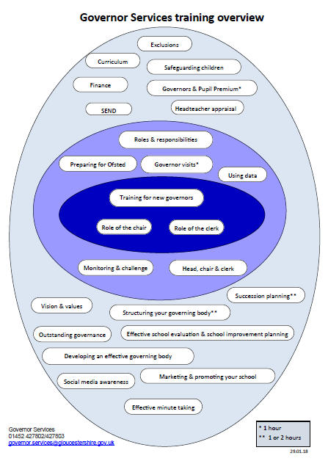
Governor training
Notes:
Handout: one per person – of the ‘egg’
The importance of training (ref to Governance handbook s4.2 : Training & Development)
All boards are responsible for identifying the induction and other ongoing training and development they need.
They should set aside a budget for this purpose
Effective boards encourage everyone involved in governance to make the most of the resources, guidance and training available to develop their knowledge and skills
So, please check (annually?) who has had what training and when
Identify gaps and then plan to fill those gaps, ie, secure training (can be sourced from a variety of places but obviously LA)
Egg (Know you’ve seen it before, but got a bit more time to talk about it today)
Range of training topics – some ‘essential’, some ‘developmental’, some ‘specialist’ (which are delivered by specialist LA teams).
Some are delivered centrally, some available on site of your school. (Central dates for next year just being finalised)
Whatever you are interested in, do talk to GS – we can be flexible, and can make training bespoke.

Slide 51
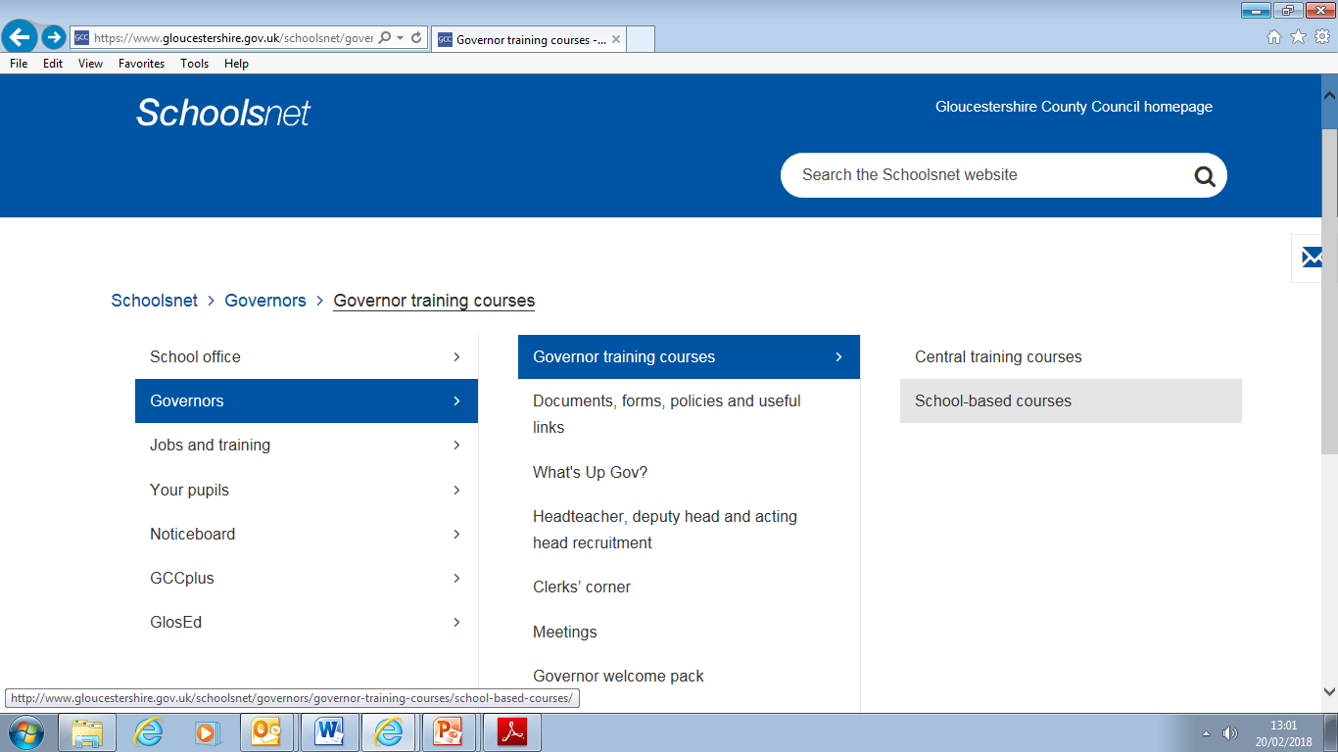
Governor training
Notes:
Range of training topics – some ‘essential’, some ‘developmental’, some ‘specialist’ (which are delivered by specialist LA teams).
Some are delivered centrally, some available on site of your school. (Central dates for next year just being finalised)
And, do check if you are entitled to something / or owed something. It may be training is included in the GS package you purchased from GCCplus.
3 training packages available :
1 : GS helpline
2 : GS helpline plus 2 central days
3 : GS helpline plus 1 school-based session
The point is – check what you’ve had, what you need, and speak to GS about what it is you need
Whatever you are interested in, do talk to GS – we can be flexible, and can make training bespoke.
For example – we put on a Complaints event in response to need and it was v successful.
Opportunity to discuss experience of governor training?

Slide 52
Social media
Notes:
Can be a fabulous method of communication with community / parents / etc, but also can cause problem for schools.
Comments on social media from parents can be inaccurate, defamatory or even abusive. You have little redress – other than appealing to the author to stop
We do have a school based course which governors may find helpful. It consider some general info (about the legal age range for children on particular sites), it considers how the school can manage its own social media presence, and considers the problems which can arise…
Discuss : own experience?? sharing good practice through discussion and capturing concerns to collate from all the briefings.

Slide 53

Barring
Notes:
It’s rare – but it does happen.
Leadership of a school may, occasionally, need to bar someone from the site – most typically a parent(s)
It’s old (2012), but the DfE do have (non-statutory) advice.
In simple terms – the DfE advice sets out a reminder that school premises are private property – and parents have permission from the school to be on site.
The advice sets out when a school may ban or bar parents from the site.
It suggests when a school intends to ban, this should be done in writing, and giving the person to be banned an opportunity to express their views.

Slide 54
Assessment and Curriculum
Notes:
Notes for presenters: There will be annotated hard copies of the notes and handouts for this section with 2 slides per page.

Slide 55

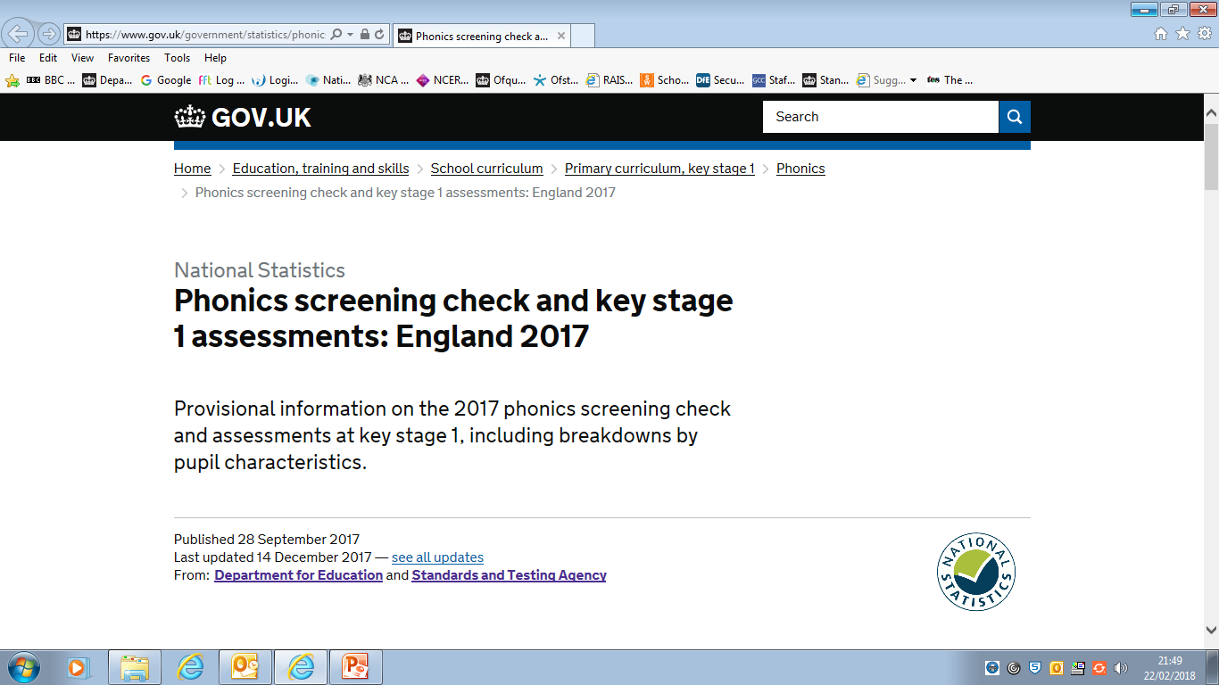
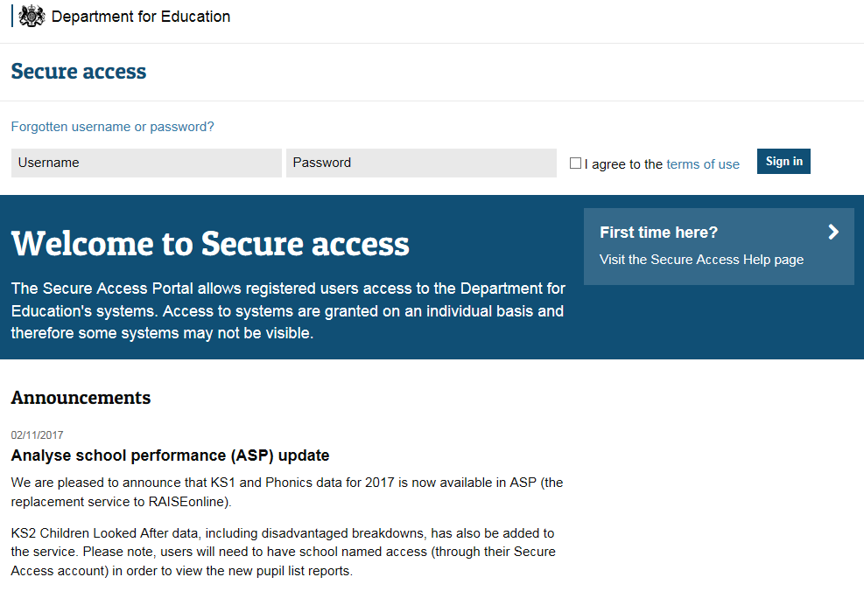
2017 KS1 and KS2 Performance Headlines
The 2017 primary school performance tables report:
results from KS2 tests in reading, GPS and mathematics;
KS2 TA in reading, writing, mathematics and science;
Average pupil progress measures in reading, writing and mathematics;
Compare to similar schools (primary/junior settings).
2017 EYFS profile results
2017 PSC/KS1 assessments
2017 KS2 national curriculum assessments
Revised statistics for 2017 at national/regional/LA level, incl. breakdown by pupil characteristics for: EYFS profile results; PSC/KS1; KS2.
Analyse School Performance (ASP) and the
Inspection Data Summary Report (IDSR)
KS2 headline measures – KS1 and phonics – EYFS –
Absence and exclusions – School characteristics.

Slide 56
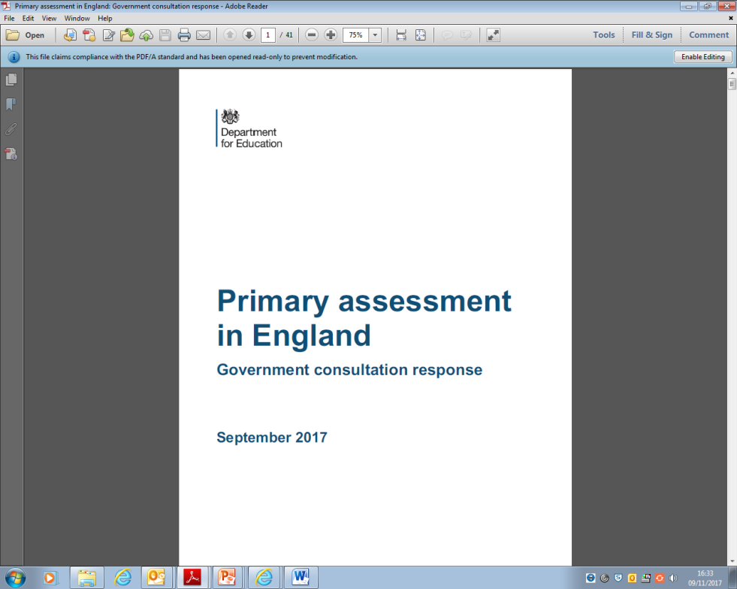
Primary assessment in England (September 2017)
Revise ELGs to ‘make them clearer and align them more closely with teaching in KS1’;
Introduce YR baseline ‘to act as the start point for measuring progress’ (2020) … therefore, new KS2 progress measures (2027);
Remove statutory KS1 TA ‘once the reception baseline is fully established’ (2023);
Introduce times tables check at the end of Y4 (2020);
Remove requirement for end of KS2 statutory TA in reading and mathematics (2019);
Improve KS1/KS2 writing TA 'by giving teachers greater scope to use their professional judgement when assessing pupils (2018);
‘Improve the statutory assessment of pupils working below the standard of national curriculum tests by extending the interim pre-key stage standards to cover all pupils engaged in subject specific learning … ’

Slide 57


Teacher assessment frameworks at the end of KS1 (February 2018)
‘In summer 2019, teachers must use these frameworks to make statutory
TA judgements for pupils at the end of KS1 in English reading, English writing,
mathematics and science. The revised English writing frameworks are the
same as those introduced for 2017/18 and remain unchanged for 2018/19 onwards.’
Teacher assessment frameworks at the end of KS2 (February 2018)
‘In summer 2019, teachers must use these frameworks to make statutory TA judgements for pupils at the end of KS2 in English writing and science.
The revised English writing frameworks are the same as those introduced
for 2017/18 and remain unchanged for 2018/19 onwards.
The frameworks do not include English reading and mathematics because schools will no longer be required to make statutory teacher assessment judgements in these subjects from 2018/19.’

Slide 58
Multiplication tables check trials to begin in schools (February 2018) link
‘A select number of schools across the country will start trialling the multiplication tables check from next month, the Schools Standards Minister Nick Gibb has announced.’
‘Results from the check will not be published at school-level, and will not be used by Ofsted and others to force changes in schools.’
Multiplication tables check: development process (February 2018) link
‘The national curriculum specifies that pupils at this stage (end of Y4) should be able to recall the multiplication tables up to and including 12x12.
The check aims to support pupils to master multiplication skills, which are essential for future success in mathematics. It will help to identify pupils who have not yet mastered this mathematical concept, so additional support can be provided.’

Slide 59

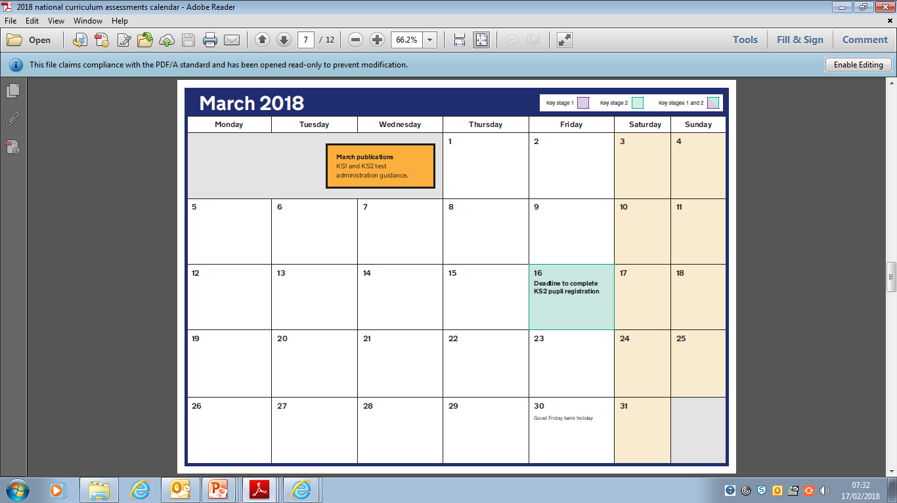
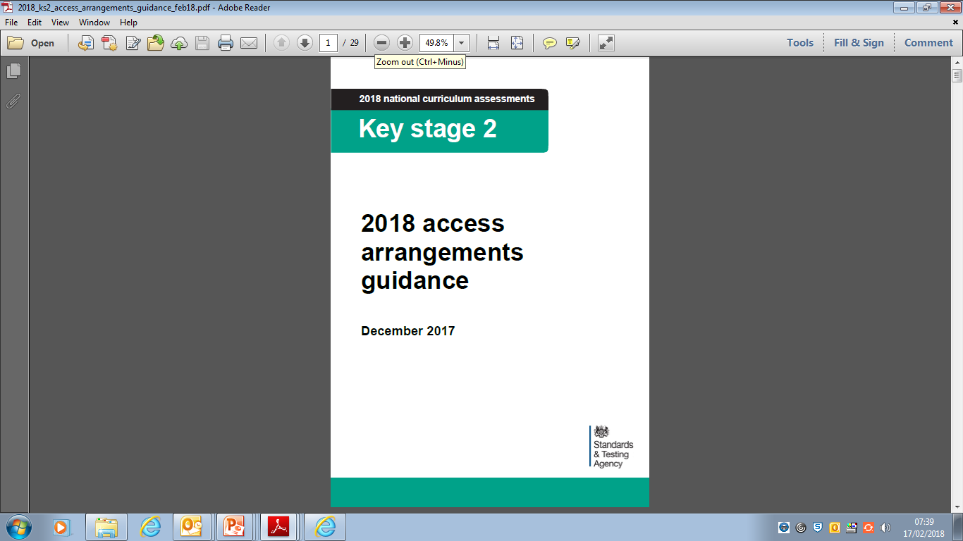
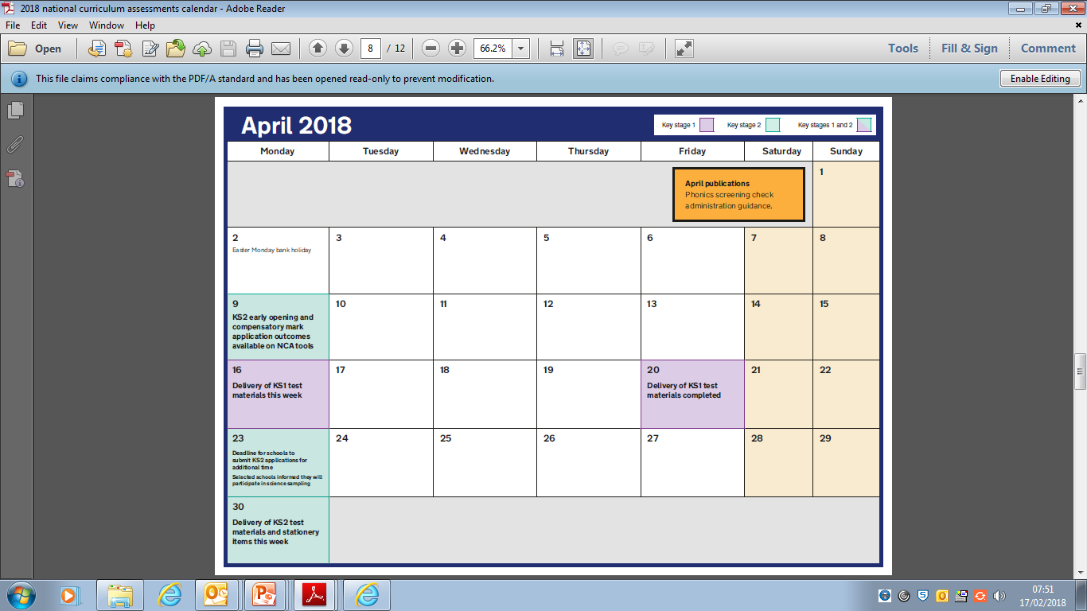
National curriculum assessments calendar (October 2017)
Important dates for primary schools to plan for the 2018 KS1 and KS2 tests, teacher assessment and the PSC.
Guidance for schools about access arrangements available for pupils participating in 2018 KS2 national curriculum tests.

Slide 60
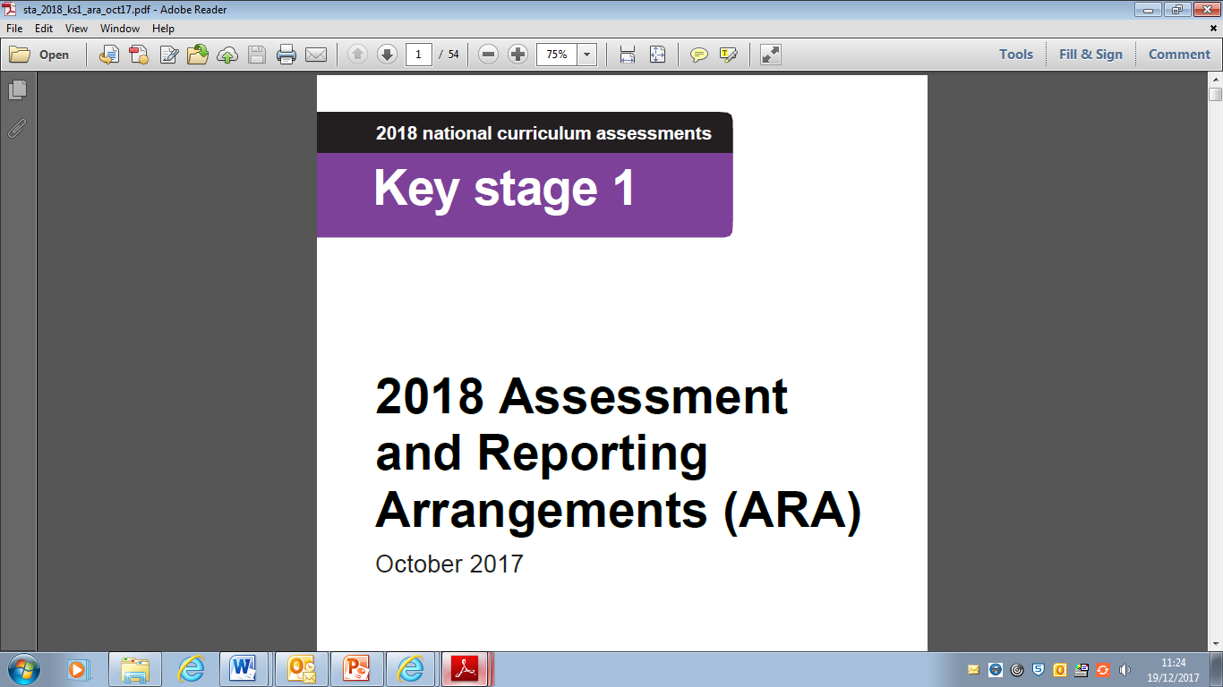
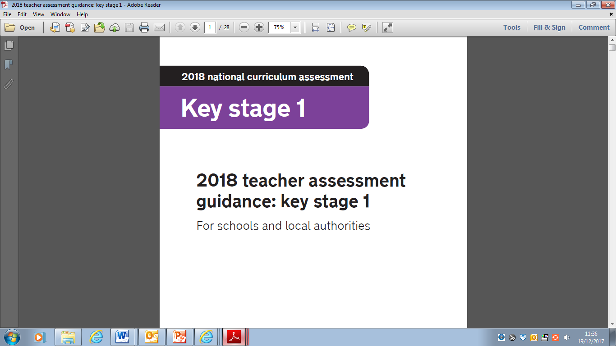
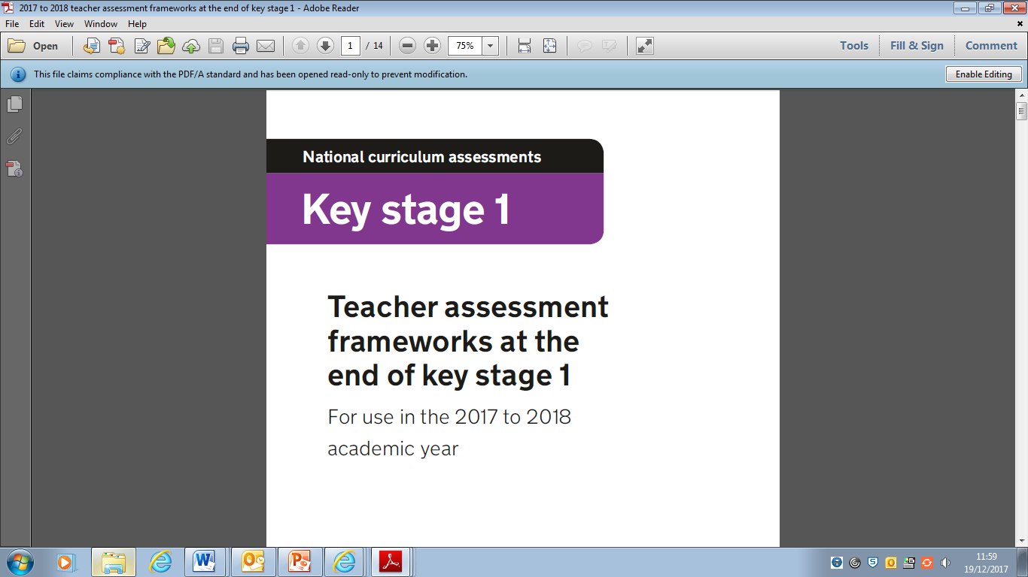
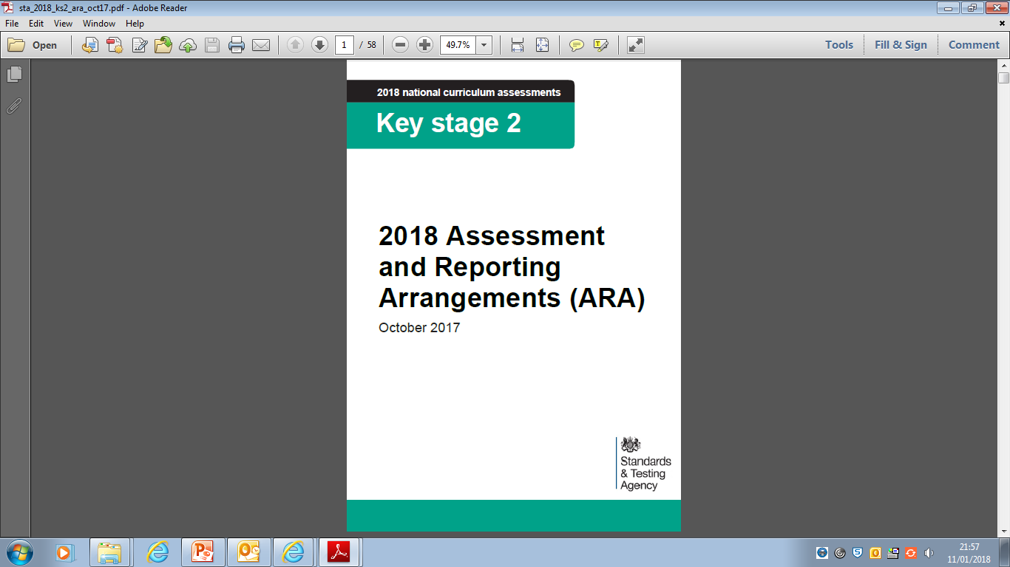

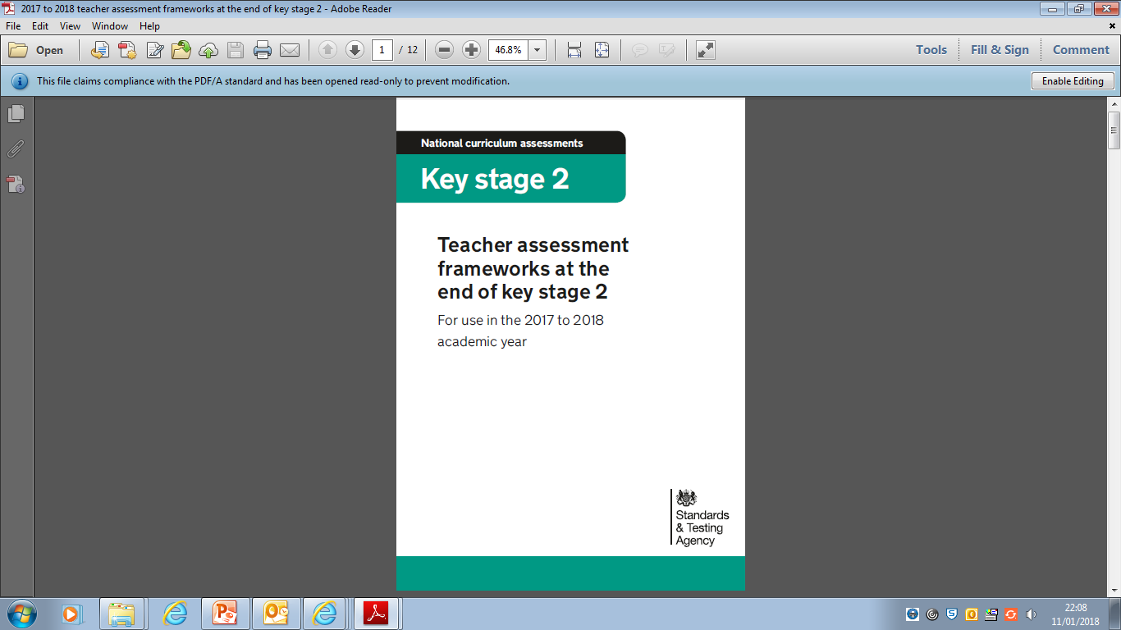
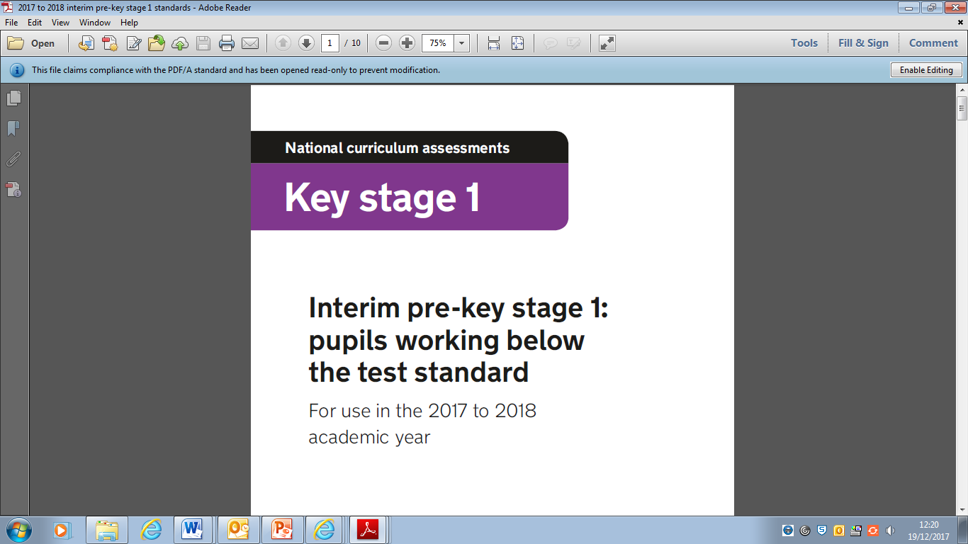

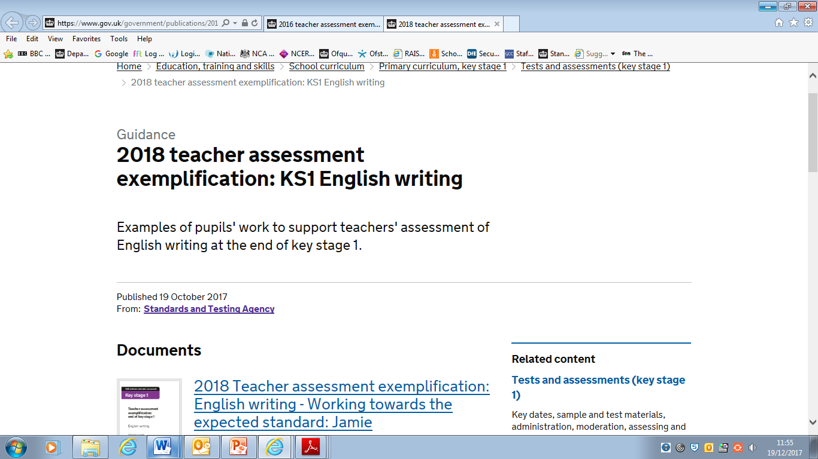
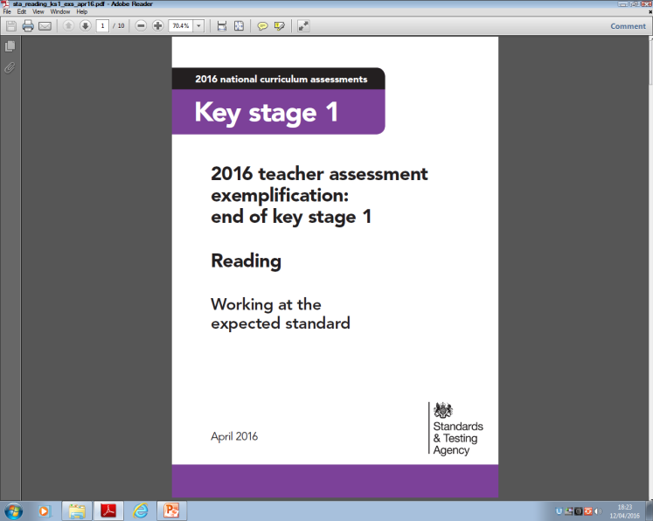
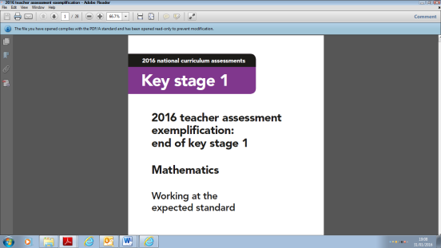
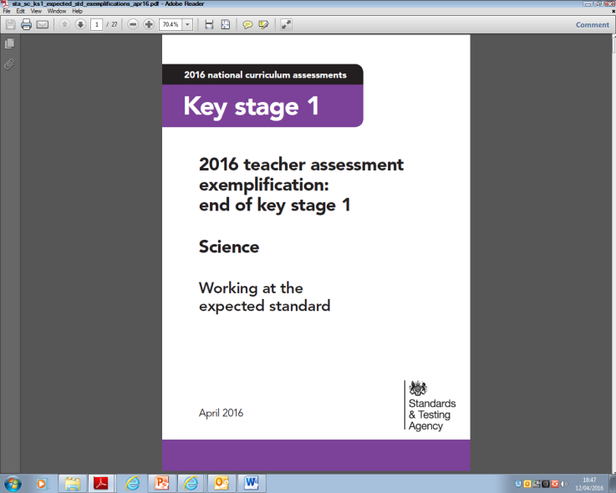
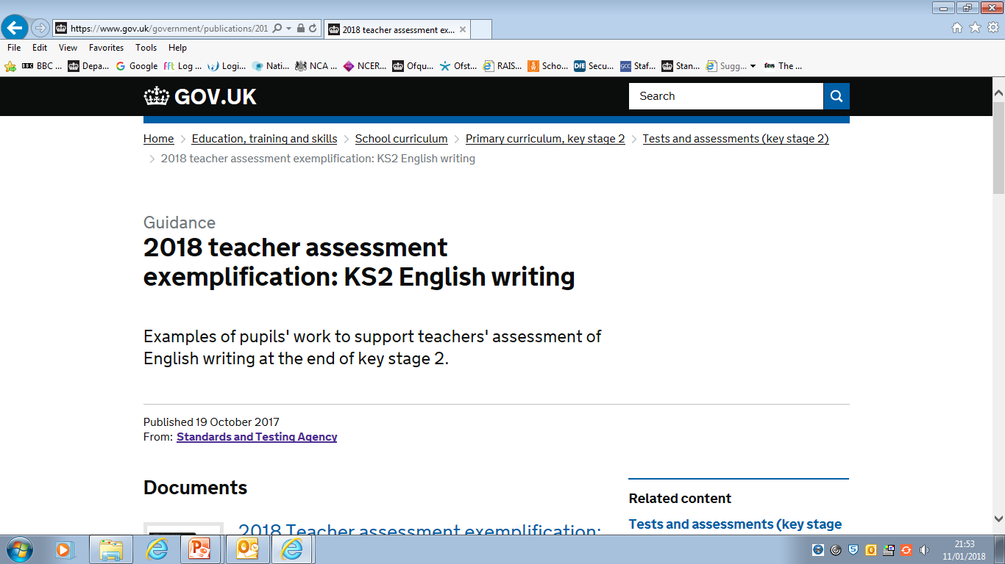
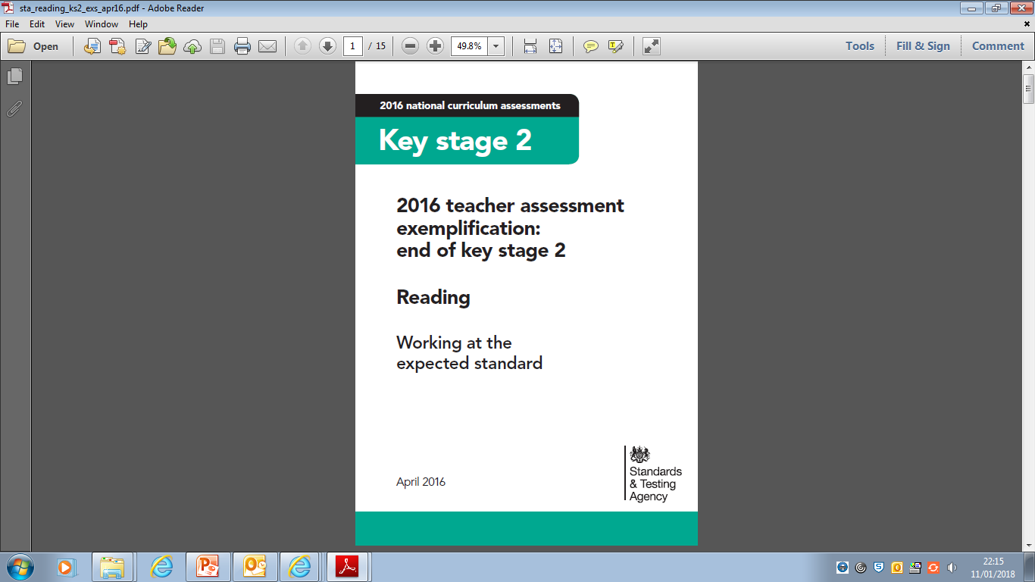


STA Guidance Documents

Slide 61
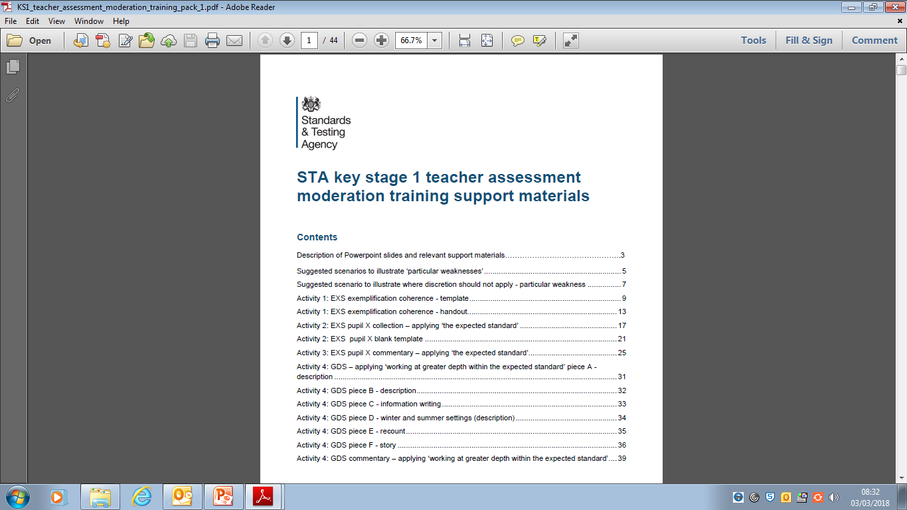
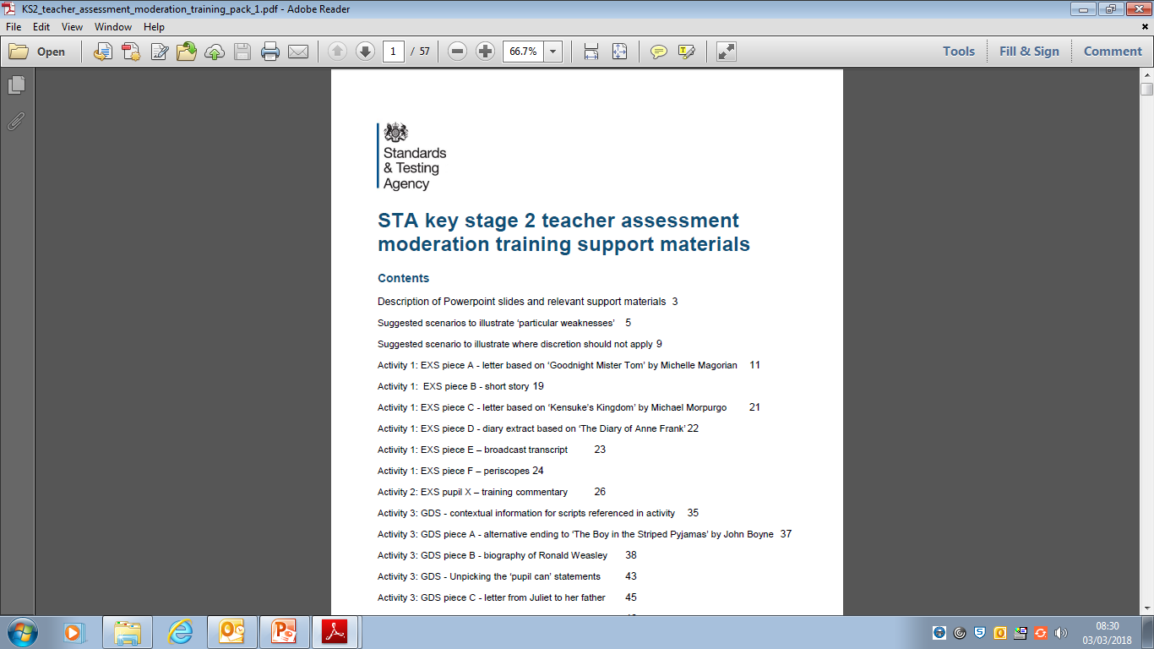
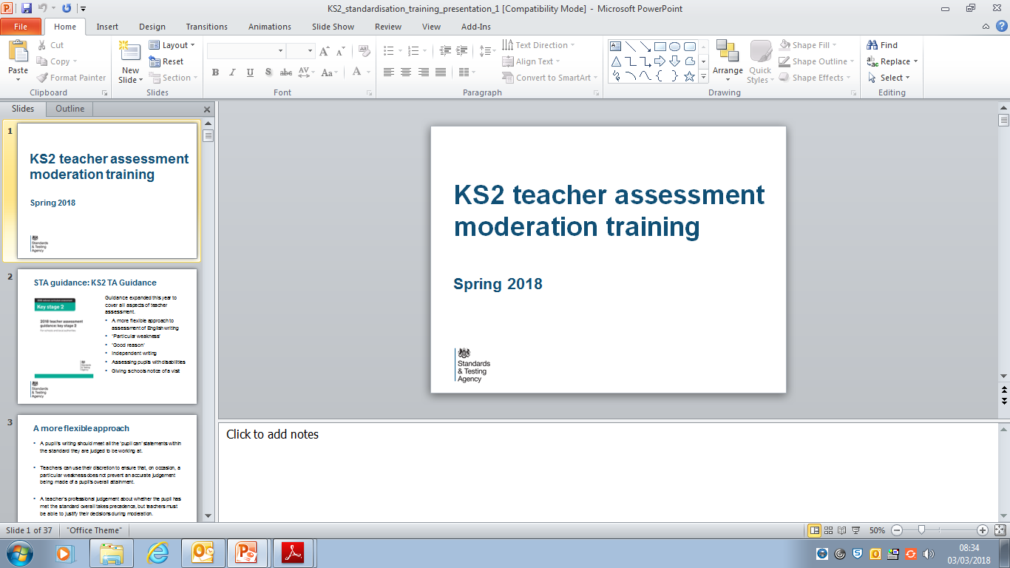
2018 Teacher Assessment: English Writing
Following national training events for local authorities (autumn 2017), the KS1 and KS2 presentation slides and accompanying materials are now available on NCA tools (‘Teacher assessment’ section).
Schools may use these resources to help prepare for the moderation of teacher assessment.
For further information email assessments@education.gov.uk or call the national curriculum assessments helpline on 0300 303 3013.

Slide 62
External Moderation of Teacher Assessment
Gloucestershire LA has the responsibility to ensure that external moderation of KS1/KS2 writing TA is carried out in line with statutory guidance as set out in these documents:
8.7 External moderation of TA (pp 35-37)
7.7 External moderation of TA (pp 34-36)
Section 8: External moderation (pp 16-22)
Section 8: External moderation (pp 17-23)
Moderation (p3)
Moderation (p3)

Slide 63
‘Moderation is a crucial part of TA. It allows teachers to
benchmark their judgements, while helping to ensure
that standards are consistent and outcomes are reliable.
Schools should ensure that their TA judgements are moderated internally and, where possible, with other schools. This will quality-assure their judgements and provide a valuable opportunity for professional development.
Every year, 25% of schools are also subject to statutory external moderation by LAs of a sample of their outcomes ... This validates judgements to ensure that they are consistent with national standards. It is a collaborative process between schools and LA moderators. STA’s TA guidance includes further information on moderation.’
2018 KS1/KS2 Teacher assessment frameworks (p3)

Slide 64
2018 KS1/KS2 Writing External Moderation
The LA will notify schools on Friday 18 May (Term 5).
LA external moderators will contact schools before the ‘Meet the Moderator’ network meeting on Wednesday 23 May (KS1 am; KS2 writing pm).
This provides teachers with an opportunity to meet their moderator prior to the school visit and to receive guidance on the external moderation process.
LA external moderation visits will take place between Monday 4 June and Thursday 28 June 2018.

Slide 65
Schools NOT selected for external moderation
Cluster assessment moderation meetings will be held across the local authority (LA) in June 2018 to support effective and accurate teacher assessment processes.
These will be for English writing (KS2) and for English reading, English writing and mathematics (KS1).
In 2018, LA external moderators will attend cluster meetings to offer additional guidance and support.
If unable to attend LA meetings, schools are requested to participate in local moderation meetings and to notify the LA of these arrangements.

Slide 66

2016 Maladministration Report
This details the allegations reported to the STA maladministration team throughout the 2016 test cycle.
Maladministration …
… ‘any act that could jeopardise the integrity, security or confidentiality of the national curriculum assessments and could lead to results that do not reflect the unaided abilities of children.’
… ‘could refer to a range of actions, including test papers being incorrectly opened, pupils cheating, over-aiding of pupils by test administrators, changes being made to pupils’ test scripts by someone other than the pupil or inflation/deflation of teacher assessment judgements.’ (p3)

Slide 67

2018-19 Primary Core Subject Leader Network Meetings For booking forms and payment details Link to primary SLNM 2018-19
English, Mathematics and Science Packages cost £240.00 to include:
3 full day meetings
Expertise and resources
Refreshments including lunch
Venue: The Pavilion, Cheltenham GL51 6PN
Notes:
Handout: flyer one per person

Slide 68

Gloucestershire Facilitated Oxford University Press Sponsored Event Reading Comprehension
19th April 2018 The Pavilion Cheltenham GL51 6PN
Target Audience: Headteachers, Senior Leaders and
English Subject Leaders
Time: full day 9.15 – 3.30
Charge: £40 to cover administration, venue and
refreshment costs including lunch
Link to agenda and how to book
Limited to 70 delegates and a maximum of 2 places per school.
Notes:
Notes: Information in Heads Up week beginning 5th March. Please point out 70 places.
Handouts: Copies for the tables: flyer and full agenda.

Slide 69

Association for Science Education Annual Conference January 2018 Link to speech 5.01.18
Update: Ofsted Review of the Curriculum
‘A real science education
In science specifically, the results of our study were not too dissimilar from the picture more generally. In primary, there is a continued narrowing of the curriculum where schools’ understandable desire to ace the English and maths SATs has been squeezing the science curriculum out.’
See also: Speech 1st February 2018 Link to speech

Slide 70
Ofsted Review of the Curriculum January 2018 continued
‘Knowledge-based enquiry
In preparing for today, I went back to the stated aims of the national curriculum for science. I always find it surprising the number of people who haven’t read the national curriculum; I would highly recommend you do. The aims are firstly ‘to ensure that all pupils develop scientific knowledge and conceptual understanding through the specific disciplines of biology, chemistry and physics’; secondly to ‘develop understanding of the nature, processes and methods of science through different types of science enquiries that help them to answer scientific questions about the world around them’, and lastly to ensure all pupils ‘are equipped with the scientific knowledge required to understand the uses and implications of science, today and for the future’.

Slide 71
REMINDER: 2018 Teacher assessment frameworks: end of KS1 and KS2
‘Guidance
When assessing science, there is no requirement to have evidence from the classroom that pupils have met statements relating to science content taught before the final year of the key stage.’
(Page 1 of KS1 and KS2 Assessment Frameworks)
Notes:
Previously: assessment was drawn from across Year 1 and Year 2 for science content.

Slide 72

Bold beginnings: The Reception curriculum in a sample of good and outstanding primary schools (Ofsted, November 2017)
This report looks at the Reception curriculum in successful schools and how well it prepared 4 and 5-year-olds for the rest of their education and beyond.
In January 2017, Ofsted’s Chief Inspector Amanda Spielman commissioned an Ofsted-wide review of the curriculum. Its aim was to provide fresh insight into leaders’ curriculum intentions, how these are implemented and the impact on outcomes for pupils.
During the summer term 2017, inspectors visited successful primary schools in which children achieved well. This report examines the provision in their Reception Year and how well it was preparing 4 and 5-year-olds for their years of schooling and life ahead.’

Slide 73
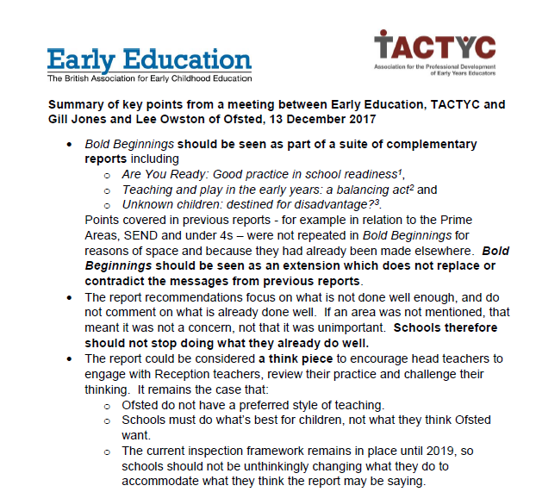
Bold beginnings: The Reception curriculum in a sample of good and outstanding primary schools (Ofsted, November 2017)
Summary of key points from a meeting between Early Education, TACTYC and Gill Jones and Lee Owston of Ofsted, 13 December 2017
Bold Beginnings should be seen as part of a suite of complementary reports including:
Are You Ready: Good practice in school readiness (Ofsted, April 2014);
‘Teaching and play in the early years: a balancing act (Ofsted, July 2015);
‘Unknown children: destined for disadvantage? (Ofsted, July 2016)
Notes:
Handout: summary – one per person

Slide 74
EYFS Update

Slide 75
Key updates from new Early Years Foundation Stage Profile Handbook 2018
Preparation for LA moderation visit
Governor run pre-school settings

Slide 76
Evidence for the Profile
There is no requirement that evidence should be formally recorded or documented. Practitioners should keep paperwork to the minimum needed to illustrate, support and recall their knowledge of the child’s attainment.
A setting’s assessment policy should outline when it is necessary to record evidence. In developing their policies, settings should consider how to minimise practitioner workload so that practitioners can focus their efforts on teaching.

Slide 77
Practitioners will build up a significant professional knowledge of each child. This professional judgement will be used to make a rounded judgement of the development of pupils against the ELGs. There is, therefore, no requirement for extensive evidence against each of the ELGs. The judgement of professionals should be trusted, freeing teachers to spend more time teaching and less time gathering and collecting evidence.
P.27 2018 EYFSP Handbook

Slide 78
When evidence does need to be recorded, this should follow the principles and recommendations outlined in the independent report: Eliminating unnecessary workload associated with data management.
p.16 2018 EYFSP Handbook

Slide 79
EYFS Profile Training
It is recommended that practitioners responsible for the completion of the EYFS profile attend LA training.
P.34 2018 EYFSP Handbook
All practitioners responsible for the completion of the EYFS profile who are not receiving a moderation visit should take part in training.
P.44 2018 EYFSP Handbook

Slide 80
External Moderation visits:
LA external moderators must provide the setting with:
the agreed, validated judgements for all moderated children
any concerns that require further action by the setting or LA
The record must be signed by the headteacher (or representative) and LA external moderator(s).
p.42 2018 EYFSP Handbook

Slide 81
Schools being moderated should:
Access the Gloucestershire Moderation Plan
Send a teacher to the moderation workshops in March (all
schools can attend)
Ensure the email informing the school has been passed on to the teacher/s
Identify teachers new to moderation who may benefit from “Dispelling the myths of moderation training” in April
For the purpose of the moderation visit make interim judgements against each of the 17 ELGs
Notes:
Please let EYFS teachers know as soon as you know, it is helpful at the Moderation workshops for us to discuss details of the forthcoming visits and CT’s can ask us questions that they may have.
Glos LA Training:
Moderation workshops throughout the county in February/March – all schools able to attend - 1 per setting
Dispelling the Myths of Moderation for teachers new to the process in April, invitation to attend sent out with notification letter

Slide 82
Governor run pre-schools
In a school with a governor run, school based pre-school group the term ‘Early Years’ refers to all of the early years provision in the school run by the governing body i.e. reception and pre-school
Improvement activity in governor run preschool settings falls under the remit of the HT
The performance adviser linked to the school will discuss all aspects of the Early Years provision including the pre-school.

Slide 83
Inspection of Governor run pre-schools
School inspection, including inspection in academies and free schools, covers all of the early years provision run by the governing body i.e. it will take into account the early years provision in the Reception class and the pre-school provision.
Pre-school settings that are governor run are inspected as part of the schools’ Ofsted inspection.
These settings no longer have a separate Early Years inspection.

Slide 84
A judgement will be made on the effectiveness of early years provision. Inspectors may decide not to report separately on the provision in early years if this risks identification of pupils because numbers are so small. Typically, this will be when there are fewer than five pupils.
Where the Early Years judgement is ‘requires improvement’ or ‘inadequate’ all of the Early Years provision will be discussed by the Head Teacher and the Performance Adviser linked to the school to determine the next steps.

Slide 85
Where improvement is needed in the pre-school or Reception provision the Performance Adviser may request support from a colleague with an early years specialism or from the Early Years Service.
In order to continue pre-school EY funding, the LA will require the pre-school setting to provide evidence of quality improvement activity to address the concerns raised in the inspection report that specifically relate to their provision.

Slide 86
Additional Information
Useful websites:
www.foundationyears.org.uk
www.gloucestershire.gov.uk/earlyyearsteam
Email:
earlyyearsteam@gloucestershire.gov.uk

Slide 87
Evaluations
These briefings are facilitated by the local authority to provide national and local updates.
Please complete the evaluation: your feedback is important as it is used to shape our agendas.
Notes:
Notes for presenters: please request completion of the evaluation – we value the feedback.

